Slide 1

Teaching Resources and Instructors’ Guidelines
Chapter 11: Exploiting open innovation and collaboration

Slide 2
Chapter 11: Exploiting open innovation and collaboration
In the following PowerPoint slides you will find the key headings from CHAPTER 11 together with the main illustrations, tables, etc.
There are also slides summarizing the key messages in bullet-point fashion, and a wide range of activities which you can use to help students explore around these themes.
Finally there are some reflection questions which can be used as the basis for discussion or assignments.

Slide 3
Learning Objectives
After this chapter you should be able to:
understand what open innovation is, and the range of strategies and mechanisms available to apply it in practice
assess the advantages and limitations of different strategies, such as outsourcing, licensing, joint ventures and strategic alliances
identify the factors which influence the motives, outcomes and success of open innovation and strategic alliances.

Slide 4

Core themes and material from the book

Slide 5
Core themes
• Joint ventures and alliances
• Role of supplier innovation
• Forms and patterns of collaboration
• Influence of technology and organization
• Supplier collaboration
• User-led innovation
• Extreme users
• Benefits and limitations of open innovation

Slide 6
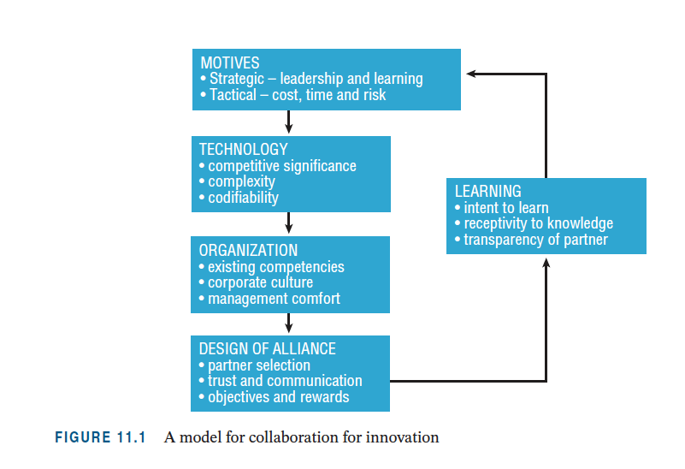
A model for collaboration

Slide 7

Joint ventures and strategic alliances
Why?
• To build critical mass through co-option.
• To reach new markets by leveraging co-specialized resources.
• To gain new competencies through organizational learning.

Slide 8
Alliances or joint ventures?
Speed: transitory alliances versus careful planning.
Partner fit: network versus dyadic fit.
Partner type: complementarity versus familiarity.
Commitment: aligned objectives versus trust.
Focus: few, specific tasks versus multiple roles.

Slide 9
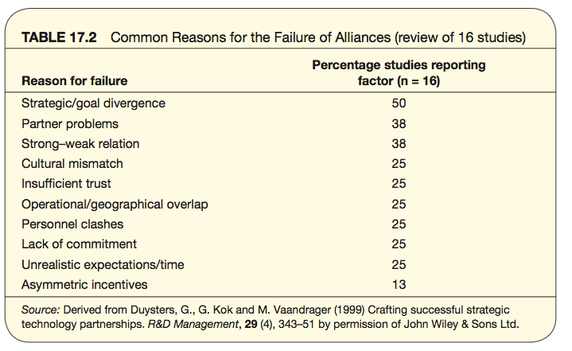
Why alliances fail

Slide 10
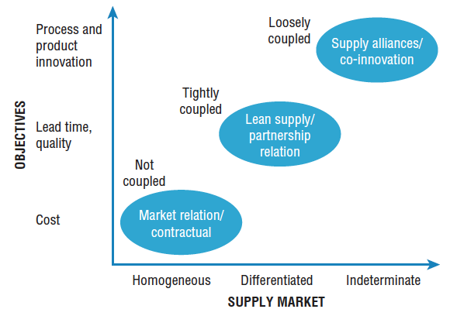
Supplier relationships

Slide 11
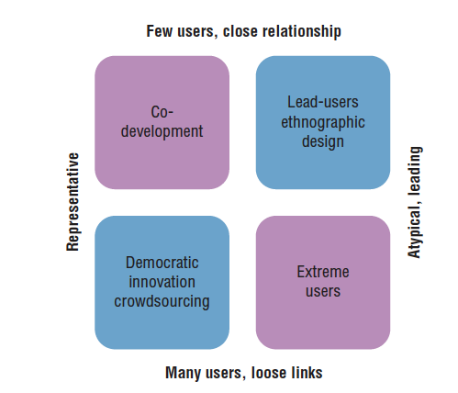
Types of user innovation

Slide 12
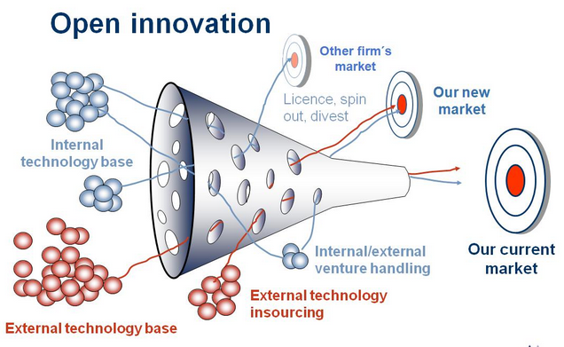
Open innovation

Slide 13
Models for open innovation
Orchestra
Creative bazaar
Jam Central
Mod station
Infusion

Slide 14
Challenges in open innovation
• conditions and context, e.g. environmental uncertainty and project complexity
• control and ownership of resources
• coordination of knowledge flows
• creation and capture of value.

Slide 15
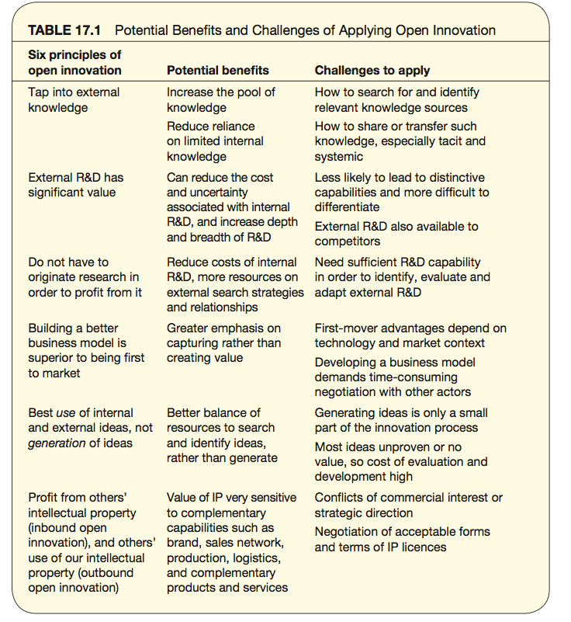
Challenges in open innovation

Slide 16
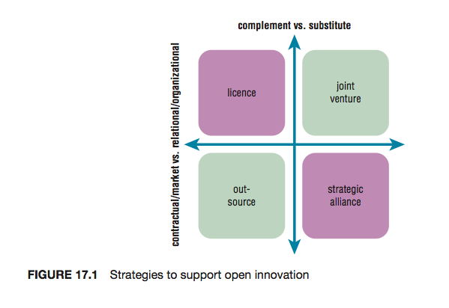
Strategies to support open innovation

Slide 17
Summary
Organizations collaborate for many reasons, to reduce the cost, time or risk of access to unfamiliar technologies or markets.
The precise form of collaboration will be determined by the motives and preferences of the partners, but their choice will be constrained by the nature of the technologies and markets, specifically the degree of knowledge complexity and tacitness.

Slide 18
Summary
The success of an alliance depends on a number of factors, but organizational issues dominate, such as the degree of mutual trust and level of communication.
Open innovation is a very broad and therefore popular concept, but needs to be applied with care as its relevance is sensitive to the context. The appropriate choice of partner and specific mechanisms will depend on the type of innovation project and environmental uncertainty.

Slide 19
Summary
In most cases open innovation and internal innovation capabilities are complementary, rather than substitutes.

Slide 20

Videos
There are several videos which can help explore and present the key themes of the chapter:
Open innovation – a golden opportunity?
Open innovation – managing knowledge spaghetti
Strategies for open innovation
Innovation contests and markets
Platforms for open innovation
Notes:
Short videos

Slide 21
Videos
Making the most of open innovation – David Simoes Brown
Outside in – part 1 of ITN /ISPIM film on user innovation
Part 2
John Bessant keynote speech on open innovation

Slide 22
Media: Joint ventures and strategic alliances
Follow the link below to hear an interview with Melissa and Doug Bernstein, founders of Melissa & Doug
https://www.youtube.com/watch?v=EvZEZfyBQ5E

Slide 23

Connect and develop
This audio interview describes experience with the ‘Connect and develop’ programme within Procter and Gamble.
The company website has more information and a wide range of examples
http://www.pgconnectdevelop.com/

Slide 24
Media: Ordnance Survey
This is an audio interview with David Overton describing the approach of a large knowledge-based organization to try and extend the range of products and services using their core knowledge base.

Slide 25
Media: Open Innovation
Follow the link below to watch Charles Leadbetter’s TED Talk, ‘The era of open innovation’
https://www.ted.com/talks/charles_leadbeater_on_innovation

Slide 26
Media: Open Innovation
Follow the link below to watch Howard Rheingold’s TED Talk, ‘The new power of collaboration’
https://www.ted.com/talks/howard_rheingold_on_collaboration

Slide 27
Blogs and podcasts
There are several podcasts and blogs picking up key themes around managing innovation as a process and some of the key variables:

Slide 28
Activities
There are a variety of activities (for both groups and individuals and for online as well as offline work. These include:

Slide 29
Activity: Open innovation in practice
Ask students to find examples of open innovation practices and try to classify against the models

Slide 30
Activity: Strengths and weaknesses of open innovation
Ask students to discuss (with examples) the strengths and weaknesses of taking a more open approach. For example, open innovation spreads the net more widely to find ideas – but it also raises big problems around intellectual property protection.
Present the results in the form of a table contrasting the two.

Slide 31
Cases
There are several case studies which highlight key themes in the chapter, including:
Lego, Threadless and Local Motors, examples of organizations using open innovation approaches built around communities
Connect and develop at Procter & Gamble
Adidas

Slide 32
Tools
There are a variety of tools which can help deal with themes raised in this chapter. You can find them on the website here
Design thinking
User-led innovation toolkit
Absorptive capacity audit
Ethnography
Lead user method

Slide 33
Assessments
The following slides offer some example assessment questions and discussion themes for individual or group activity

Slide 34
Assessment questions
1. Michael Dell didn’t invent the computer – but he built one of the most successful businesses selling them. Discuss how he makes use of a networking approach to build and sustain a competitive edge in his business.
2. Why might Joe Bloggs, famous inventor, need help in getting his great idea into widespread use? And how might a networking approach help him?
3. Innovation is a solo act – the product of the lone genius? Show how successful entrepreneurs make use of networks to help take their ideas forward.

Slide 35
Assessment questions
4. List three advantages of co-operating across networks in innovation as opposed to a ‘go –it-alone’ approach
5. Jane Wilson has come up with a great new idea for a medical sensor to help in monitoring babies while they sleep. How could she improve her chances of success with her new product idea by using a networking approach to taking it forward?

Slide 36
Assessment questions
6. ‘The problem for small firms isn’t that they’re small – it’s that they’re isolated’. How might networking help deal with the challenges of being an innovative small firm and what advantages might this approach offer?
7. XYZ Electronics want to launch a supplier development programme to get their 180 suppliers to participate more fully in the innovation process- contributing new ideas for products and services and helping improve processes around quality, delivery and cost reduction. What issues should they think about in designing and implementing such a programme?
8. ‘Open innovation’ is becoming a fashionable approach to innovation, building on the advantages of networking. But what problems might the implementation of such an approach throw up?

Slide 37
Team-based exercises
1. ‘Many hands make light work’ – or ‘Too many cooks spoil the broth’? Using examples show why networking may be a positive or negative element in enabling successful innovation. Split the group to present both sides of this argument and run the discussion as a debate.
2. Try and construct a map of the innovation network which leads to creating and delivering a new product like a new mobile phone or mp3 player.

